Slide 1


Slide 2

30 Tech Tips: Using software, hardware, data and AI to get a running start at home, on the road, or in the office
C:\> DAVEPA~1.ESQ && LEESAM~1.ESQ
Notes:
Start with confession: We don't have 30 tech tips. When Dave submitted this proposal AI wasn't yet the topic du jour. We do have some general tech tips for the first third, then we have an AI discussion in the middle third, and the final third can be either AI tool tips, or an open discussion – we'll see how things go.

Slide 3

Roadmap
General tech tips and tricks
Artificial Intelligence Description
Large Language Models
AI tools
Discussion

Slide 4
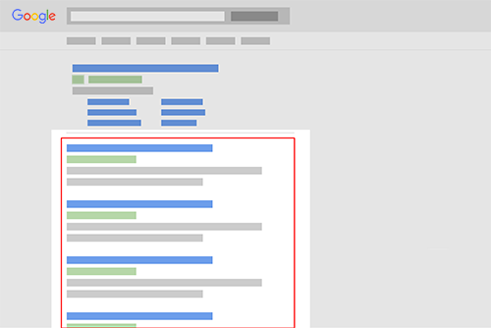
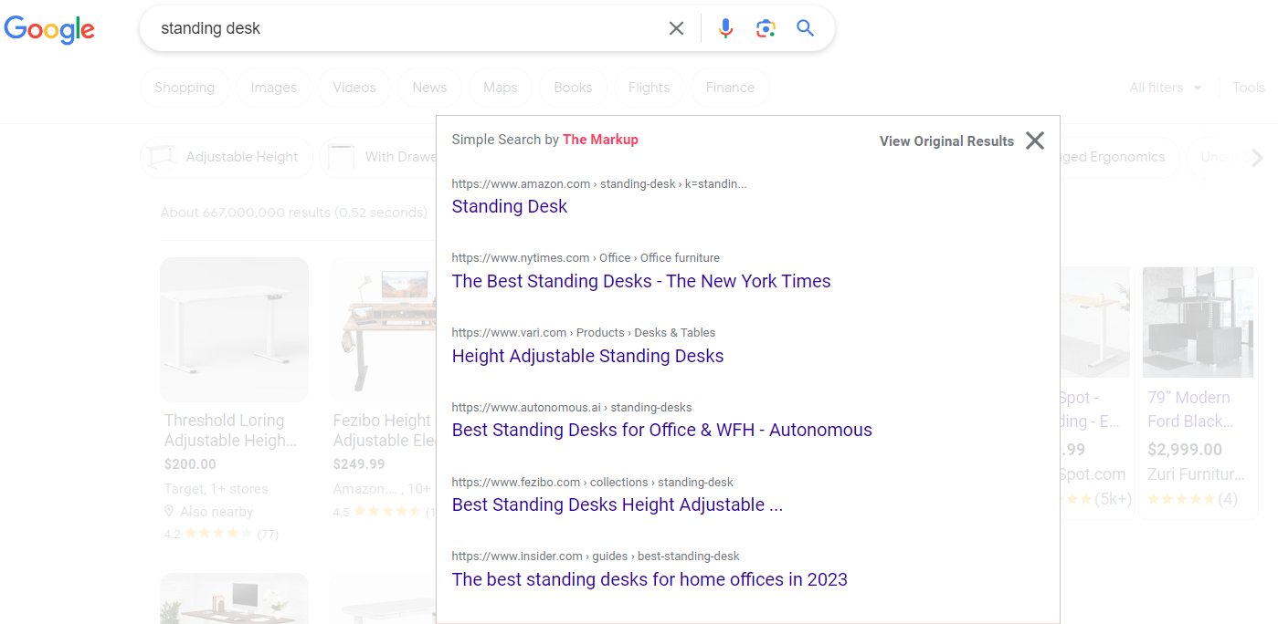
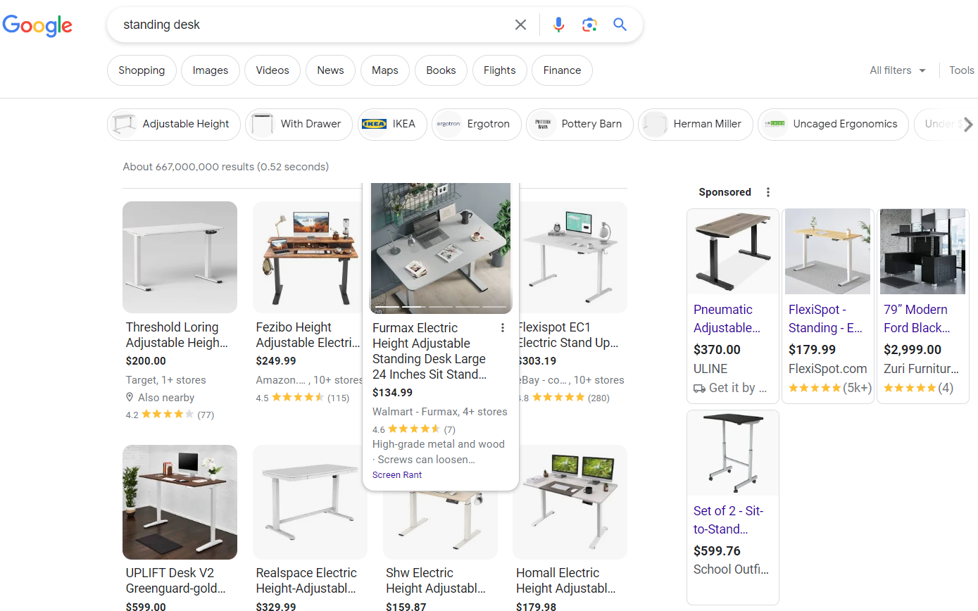

General Productivity section
Simple Search
Browser extension
Only display organic search results
A free listing in Google Search that appears because it's relevant to someone's search terms.
Non-organic search results are paid advertisements.
Notes:
This is another browser extension to aid focus. Google normally has the most relevant organic search results. An organic search result is a free listing based on relevancy. Everything else on the google search page is a paid advertisement. This screen shot demonstrates that. Some searches result in tons of ads. If I search for "standing desk" I have to scroll before I get to the organic search results. Simple Search presents a list of organic search results so I can more quickly find what I'm looking for.

Slide 5
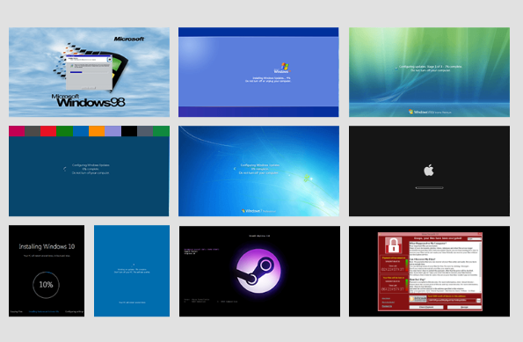
Finding Software
Capterra.com (comparisons and reviews)
AlternativeTo.net (recommendations)
Alternative.me (find software options)
Similarweb.com (analyze your website, competitors)
Fakeupdate.net

Slide 6

General Productivity section
uBlock Origin
Browser extension
Content blocker (ads, tracking, pop ups)
Desktop only
Firefox browser on Android
Notes:
This first tip is about efficiency and focus. uBlock Origin is a content blocker that stops web pages from loading ads, trackers, and pop ups. It lets you focus on the content of the page and not get distracted by ads. The extension is available for desktop browsers including Chrome, Edge, and Firefox.

Slide 7
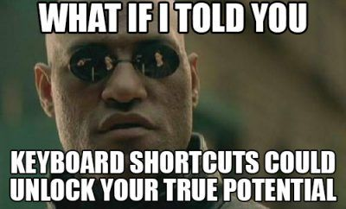
General Productivity section
Keyboard Shortcut | Function
Windows Key | Open/close Start menu
Windows Key + [start typing] | Launch apps or search files
Windows Key + A | Open Action Center
Windows Key + D | Minimize/Maximize all windows
Windows Key + E | Open File Explorer
Windows Key + I | Open Setting App
Windows Key + L | Lock the PC
Windows Key + Tab | Open Task View
Windows Key + → | Snap current window right
Windows Key + ← | Snap current window left
Ctrl + Z | Undo an action
Keyboard Shortcuts
Notes:
I type a lot. There's nothing more annoying than taking my hands off the keyboard to use the mouse to do things. Over time I've learned many helpful keyboard shortcuts to keep my hands on the keyboard and maintain my focus. Useful actions include launching apps, snapping windows around the screen, and undoing the last thing I did. A full list is available on the handout that goes with this session.

Slide 8
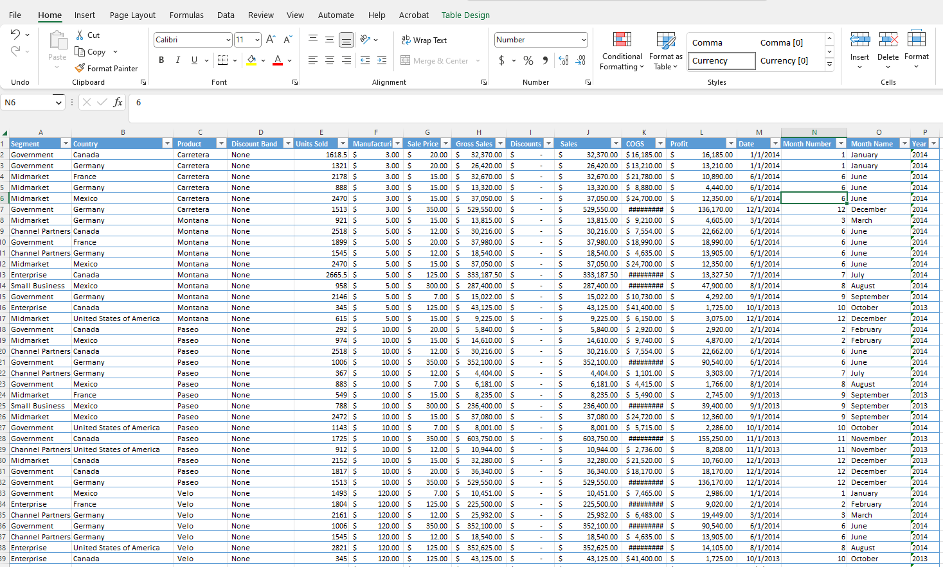
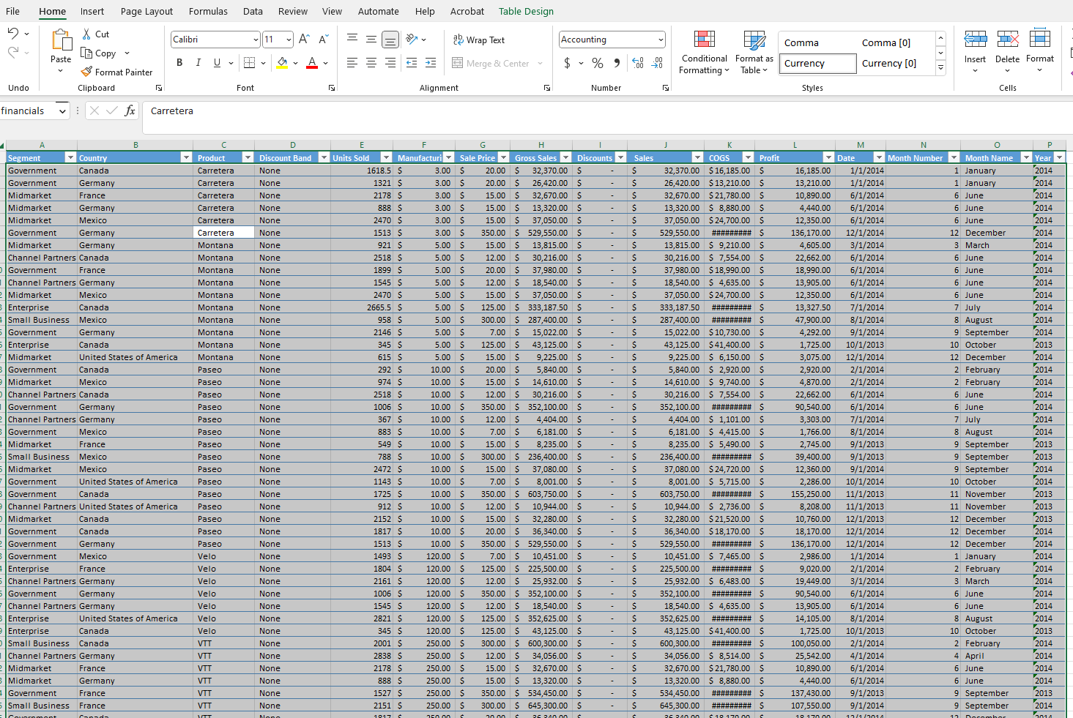
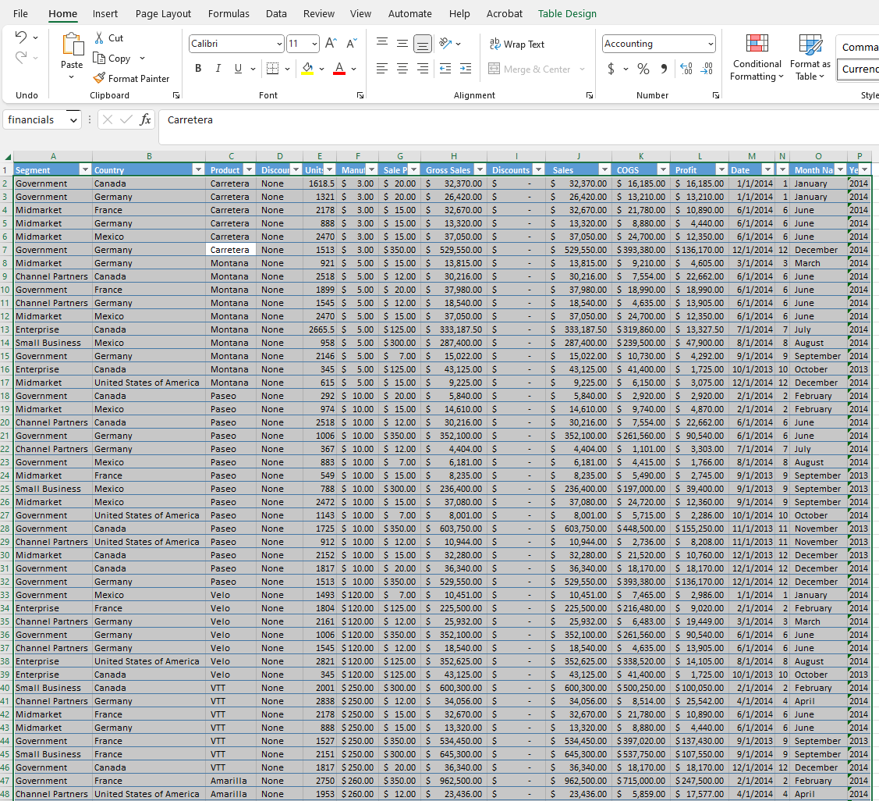
Excel shortcut – Ctrl + A; Alt + HOA / Alt + HOI

Slide 9
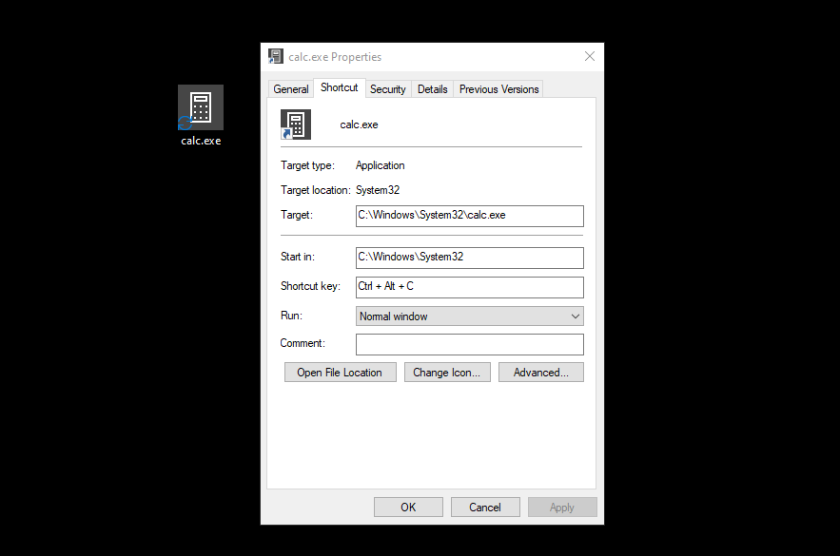
Make your own personal shortcut key!
Place a shortcut to your favorite folder, file, or program on the desktop
Right-click; Properties; Shortcut; Shortcut key; Apply
Notes:
This is a Windows 10 tool.
Start > Type Quick > Pick Quick Assist
Click help someone. This gives the helper a security code. The helpee has ten minutes to enter that code.
Helpee must then actively allow screen sharing. (Also passes sound)
Helper can then request control - if helpee approves, helper can control helpee PC.

Slide 10
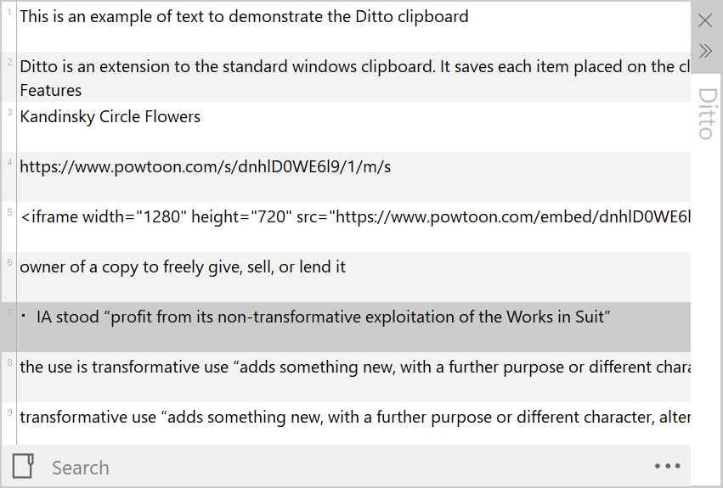

General Productivity section
Ditto
Windows app
Paste in plain text (Ctrl+Shift+V)
Notes:
Ditto is a Windows app that does one very helpful thing. It lets me move text from one app to another without bringing the formatting along. So any time I paste text with Control+Shift+V the text pastes as plain text. Ditto also keeps a running list of things I've copied to the clipboard. One note of warning, if you're often copying passwords and other sensitive data, you may want to limit how many items Ditto saves.

Slide 11
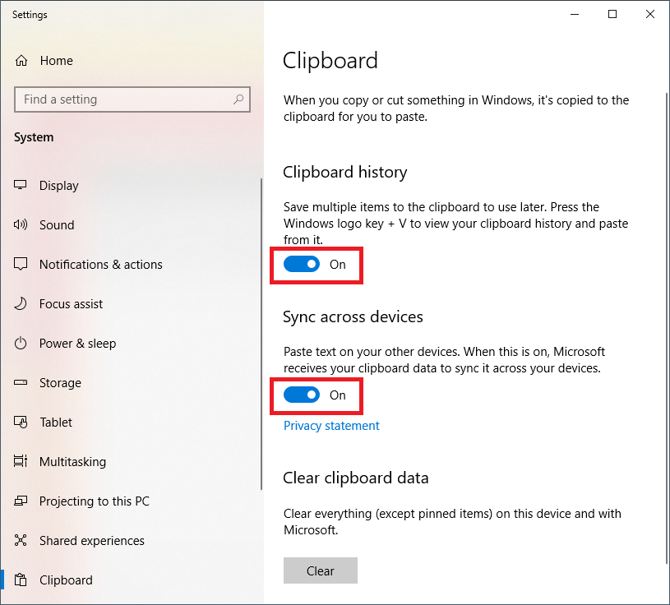
General Productivity section
Clipboard history and clipboard syncing

Slide 12

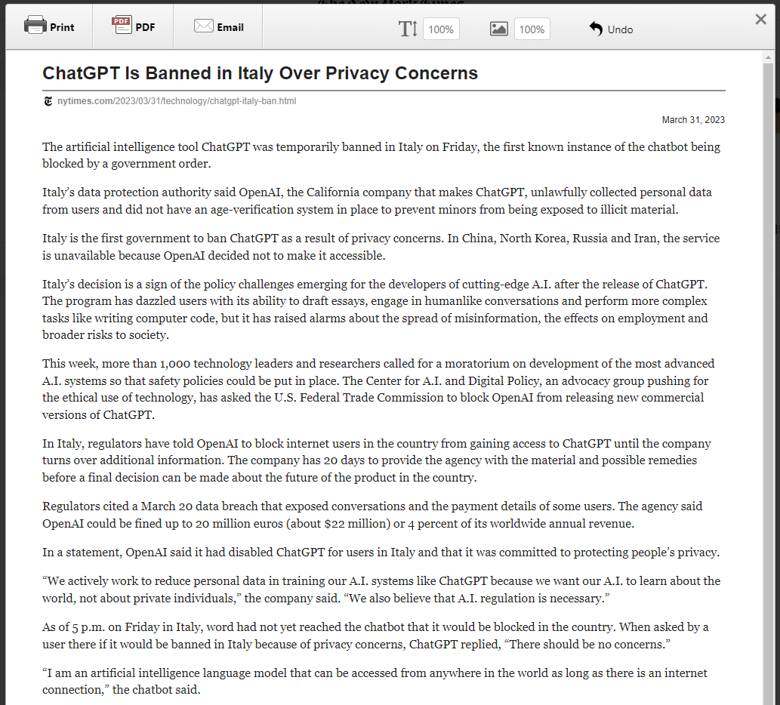
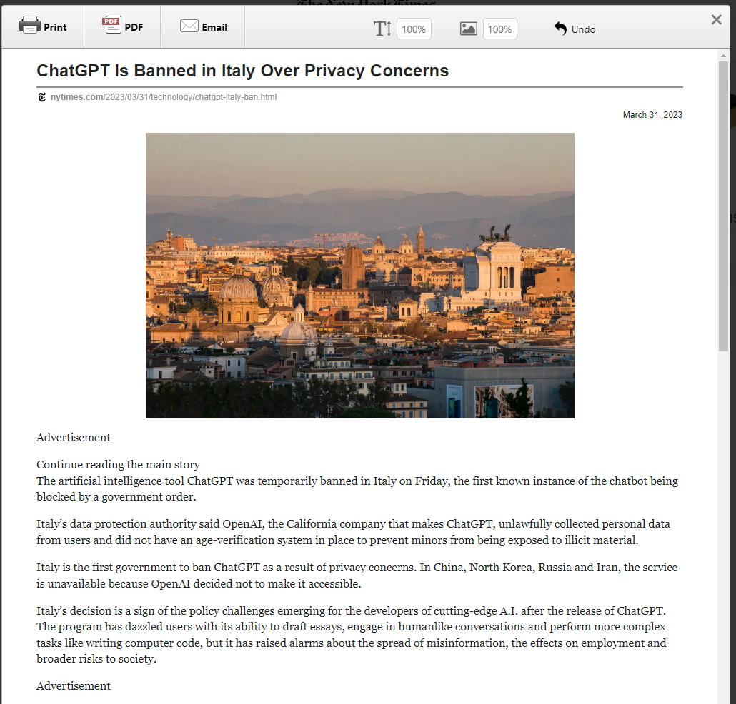
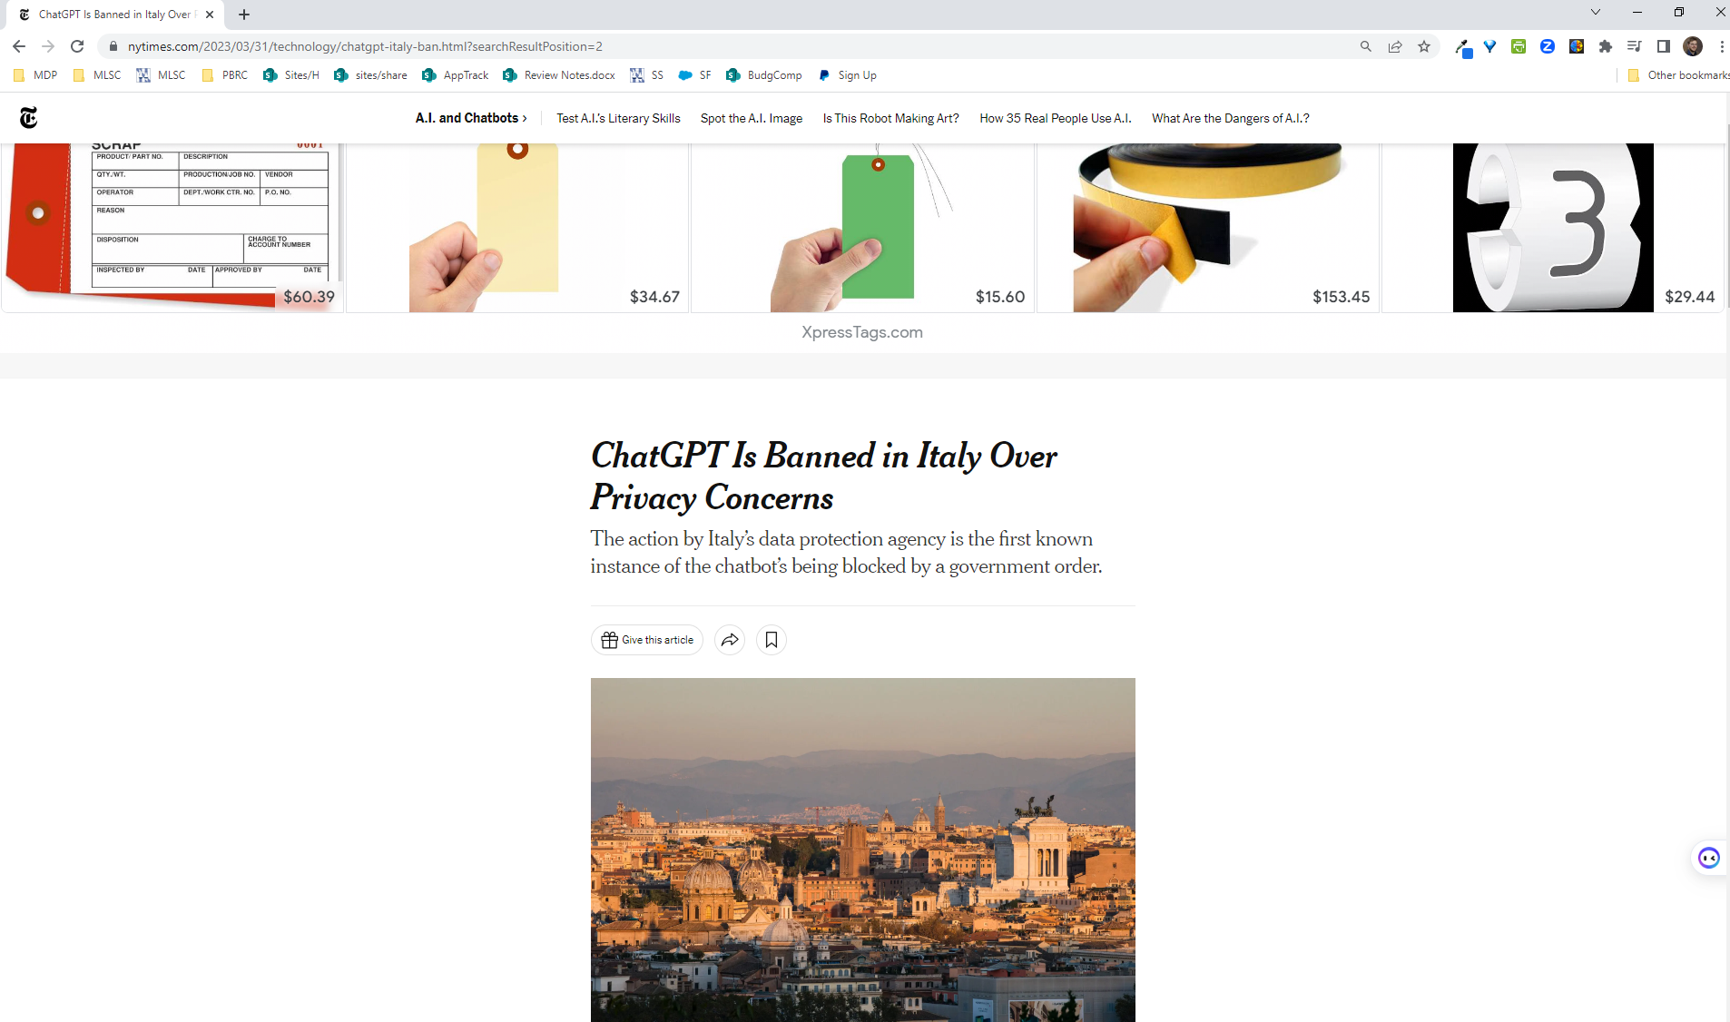
General Productivity section
Print Friendly and PDF (https://www.printfriendly.com/) Browser extension
Notes:
Print Friendly and PDF (https://www.printfriendly.com/) Browser extension
Print Preview: Optimizes and displays content for print.
Edit Before Printing: Remove images, text, and print only what you want.
Print or Save as PDF: Print now, or save for later as a PDF.

Slide 13
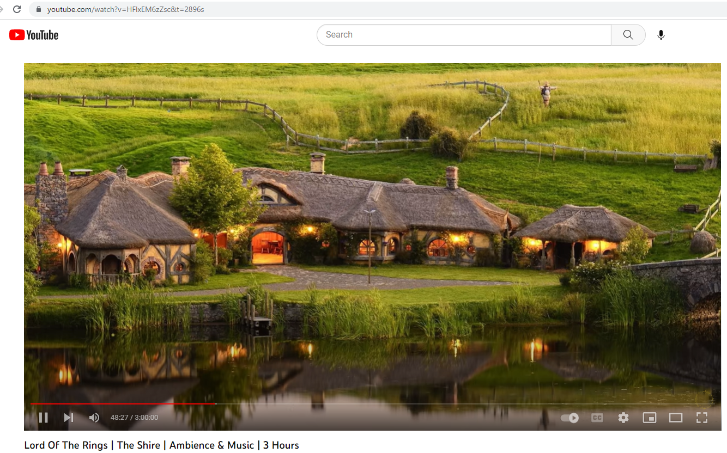
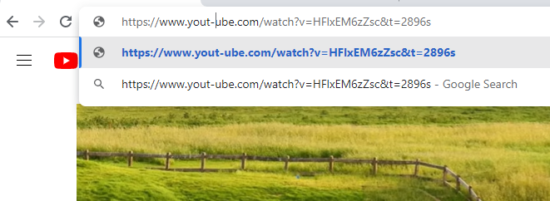
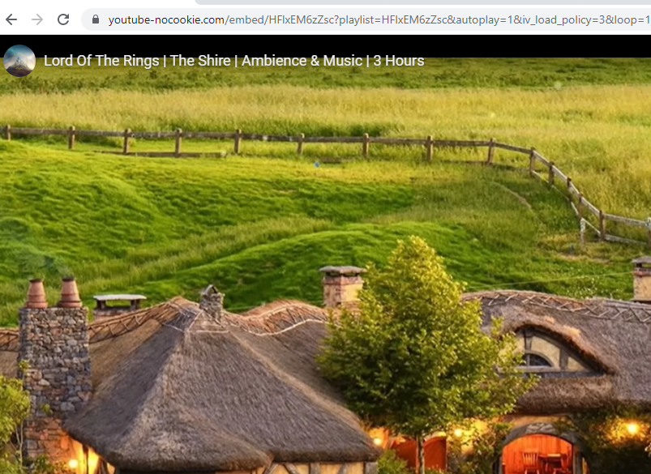
General Productivity section
Notes:
Print Friendly and PDF (https://www.printfriendly.com/) Browser extension
Print Preview: Optimizes and displays content for print.
Edit Before Printing: Remove images, text, and print only what you want.
Print or Save as PDF: Print now, or save for later as a PDF.

Slide 14
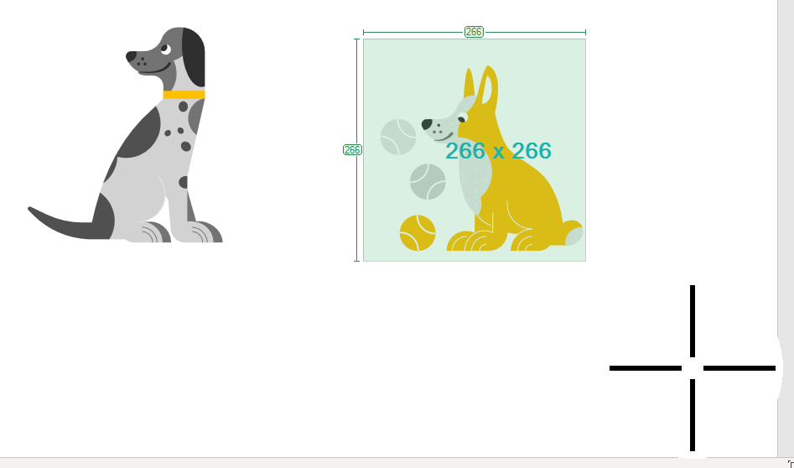
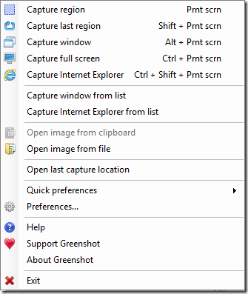

General Productivity section
Greenshot
Mac and Windows app
Powerful screen shot utility
Notes:
I use screenshots all the time. I use them when I'm making presentations like this, or when I'm documenting procedures and instructions. Greenshot is the best tool for this job. It's a free app for windows that lets you customize keyboard shortcuts to take screenshot of just a window, the whole screen, or just part of the screen. Greenshot gives you this helpful magnifier to

Slide 15
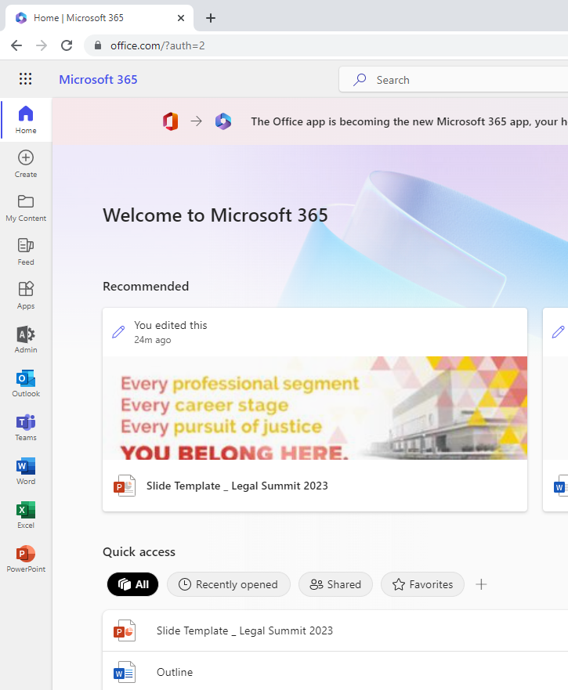
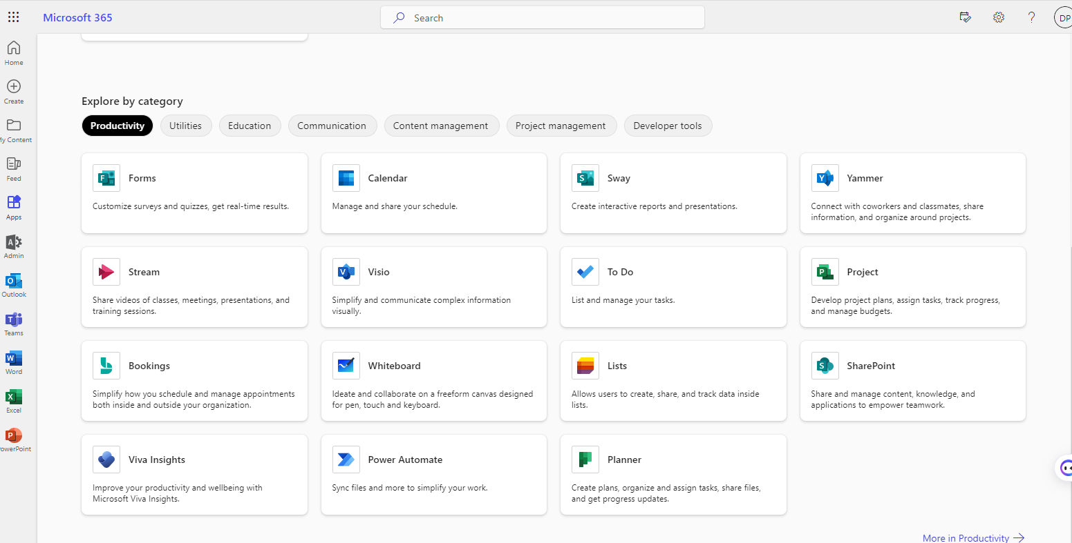
Microsoft tips – Office.com

Slide 16
Microsoft tips – Office.com
If you like… | You’ll LOVE…
Survey Monkey | Forms
Calendly | Bookings
Trello | Planner
Automating simple tasks without coding | Power Automate
Keeping inventories or contact lists in Excel | Lists
Lots of word docs about related topics | OneNote
Keeping most directories secure but sharing some with external colleagues | SharePoint

Slide 17
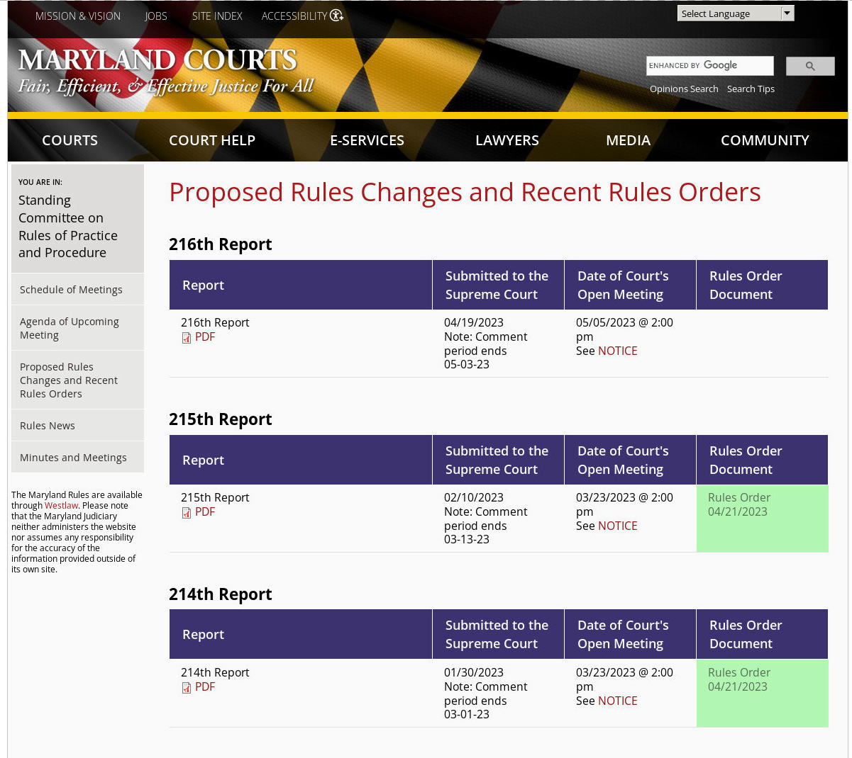
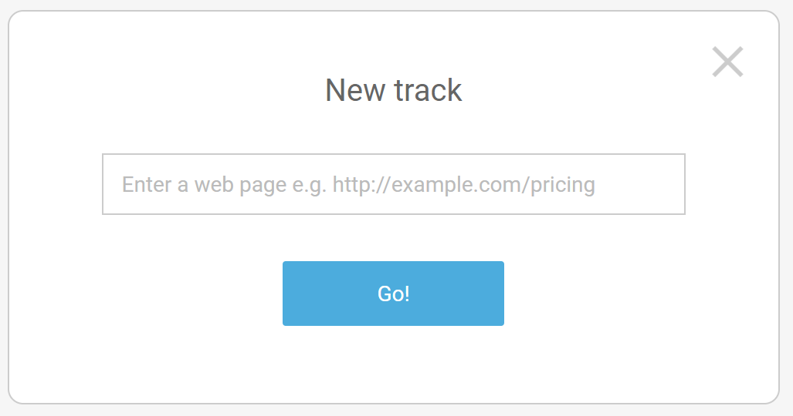
General Productivity section
Trackly.io
Web service
Monitor web pages for changes
Example: monitor Rules Committee website for new Rules Reports and Orders
Notes:
Trackly is a great monitoring tool, I have lots of websites I need to track. It's dead simple to get started, just enter the URL of the page you want to keep an eye on, tell Trackly how often you want it to check, and that's it. When Trackly detects a change in the page it will email you a screen shot. This is an example from the Rules Committee page telling me about new Rules orders I need to take a look at

Slide 18
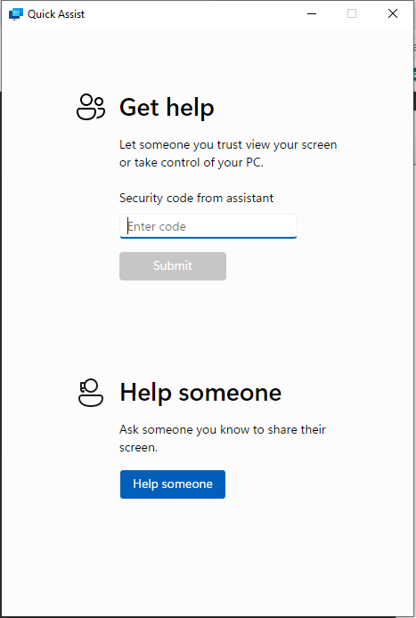
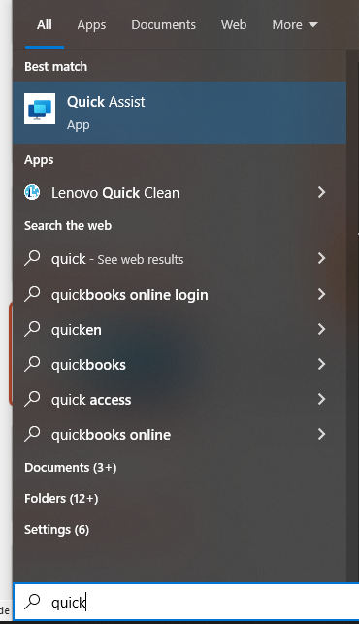
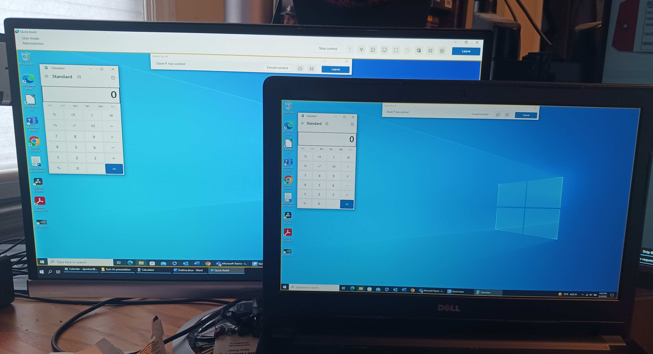
Microsoft tips – Quick Assist
Notes:
This is a Windows 10 tool.
Start > Type Quick > Pick Quick Assist
Click help someone. This gives the helper a security code. The helpee has ten minutes to enter that code.
Helpee must then actively allow screen sharing. (Also passes sound)
Helper can then request control - if helpee approves, helper can control helpee PC.

Slide 19
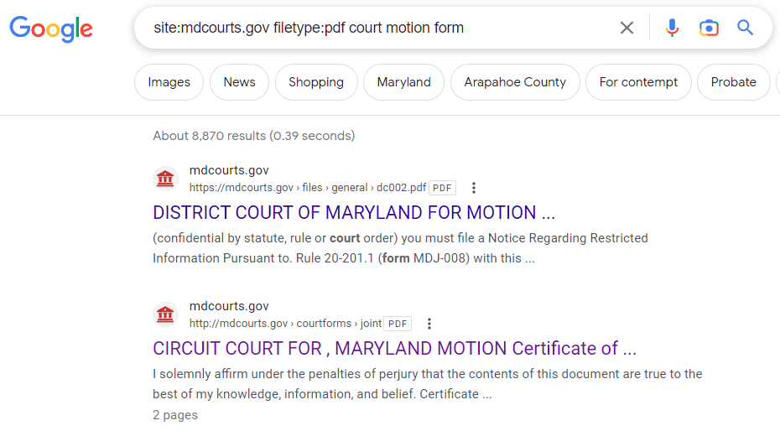
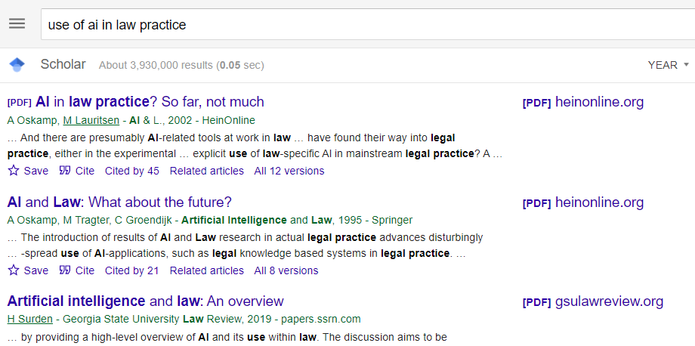
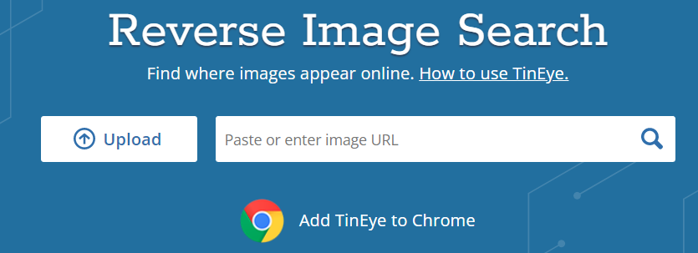
General Productivity section
Advanced search techniques
Using search engines
Operators
“tools” menu
Multiple operators
Google Scholar
Reverse image search – tineye.com
Power Searching with Google
YouTube Channel

Slide 20
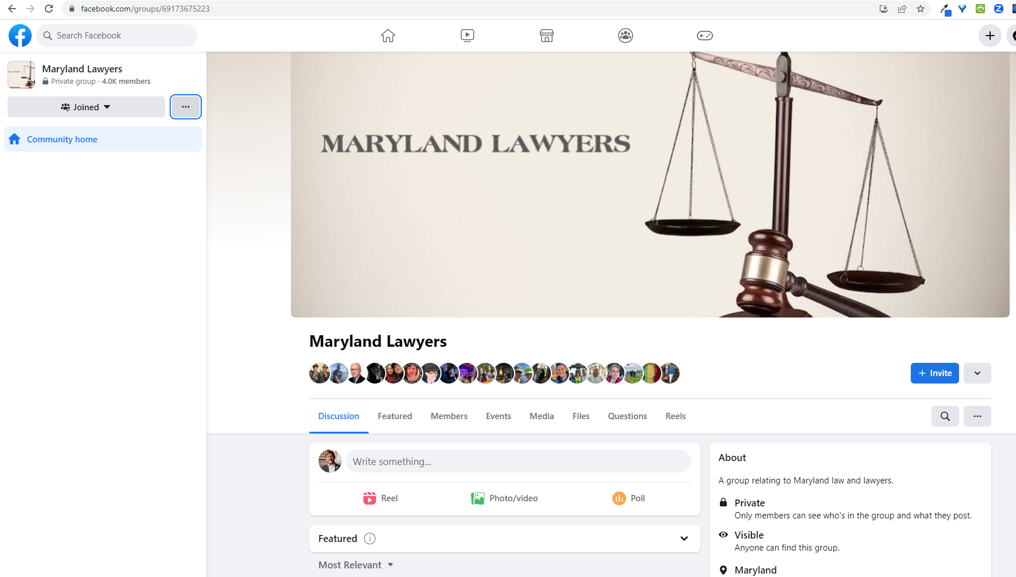
Law practice tips

Slide 21
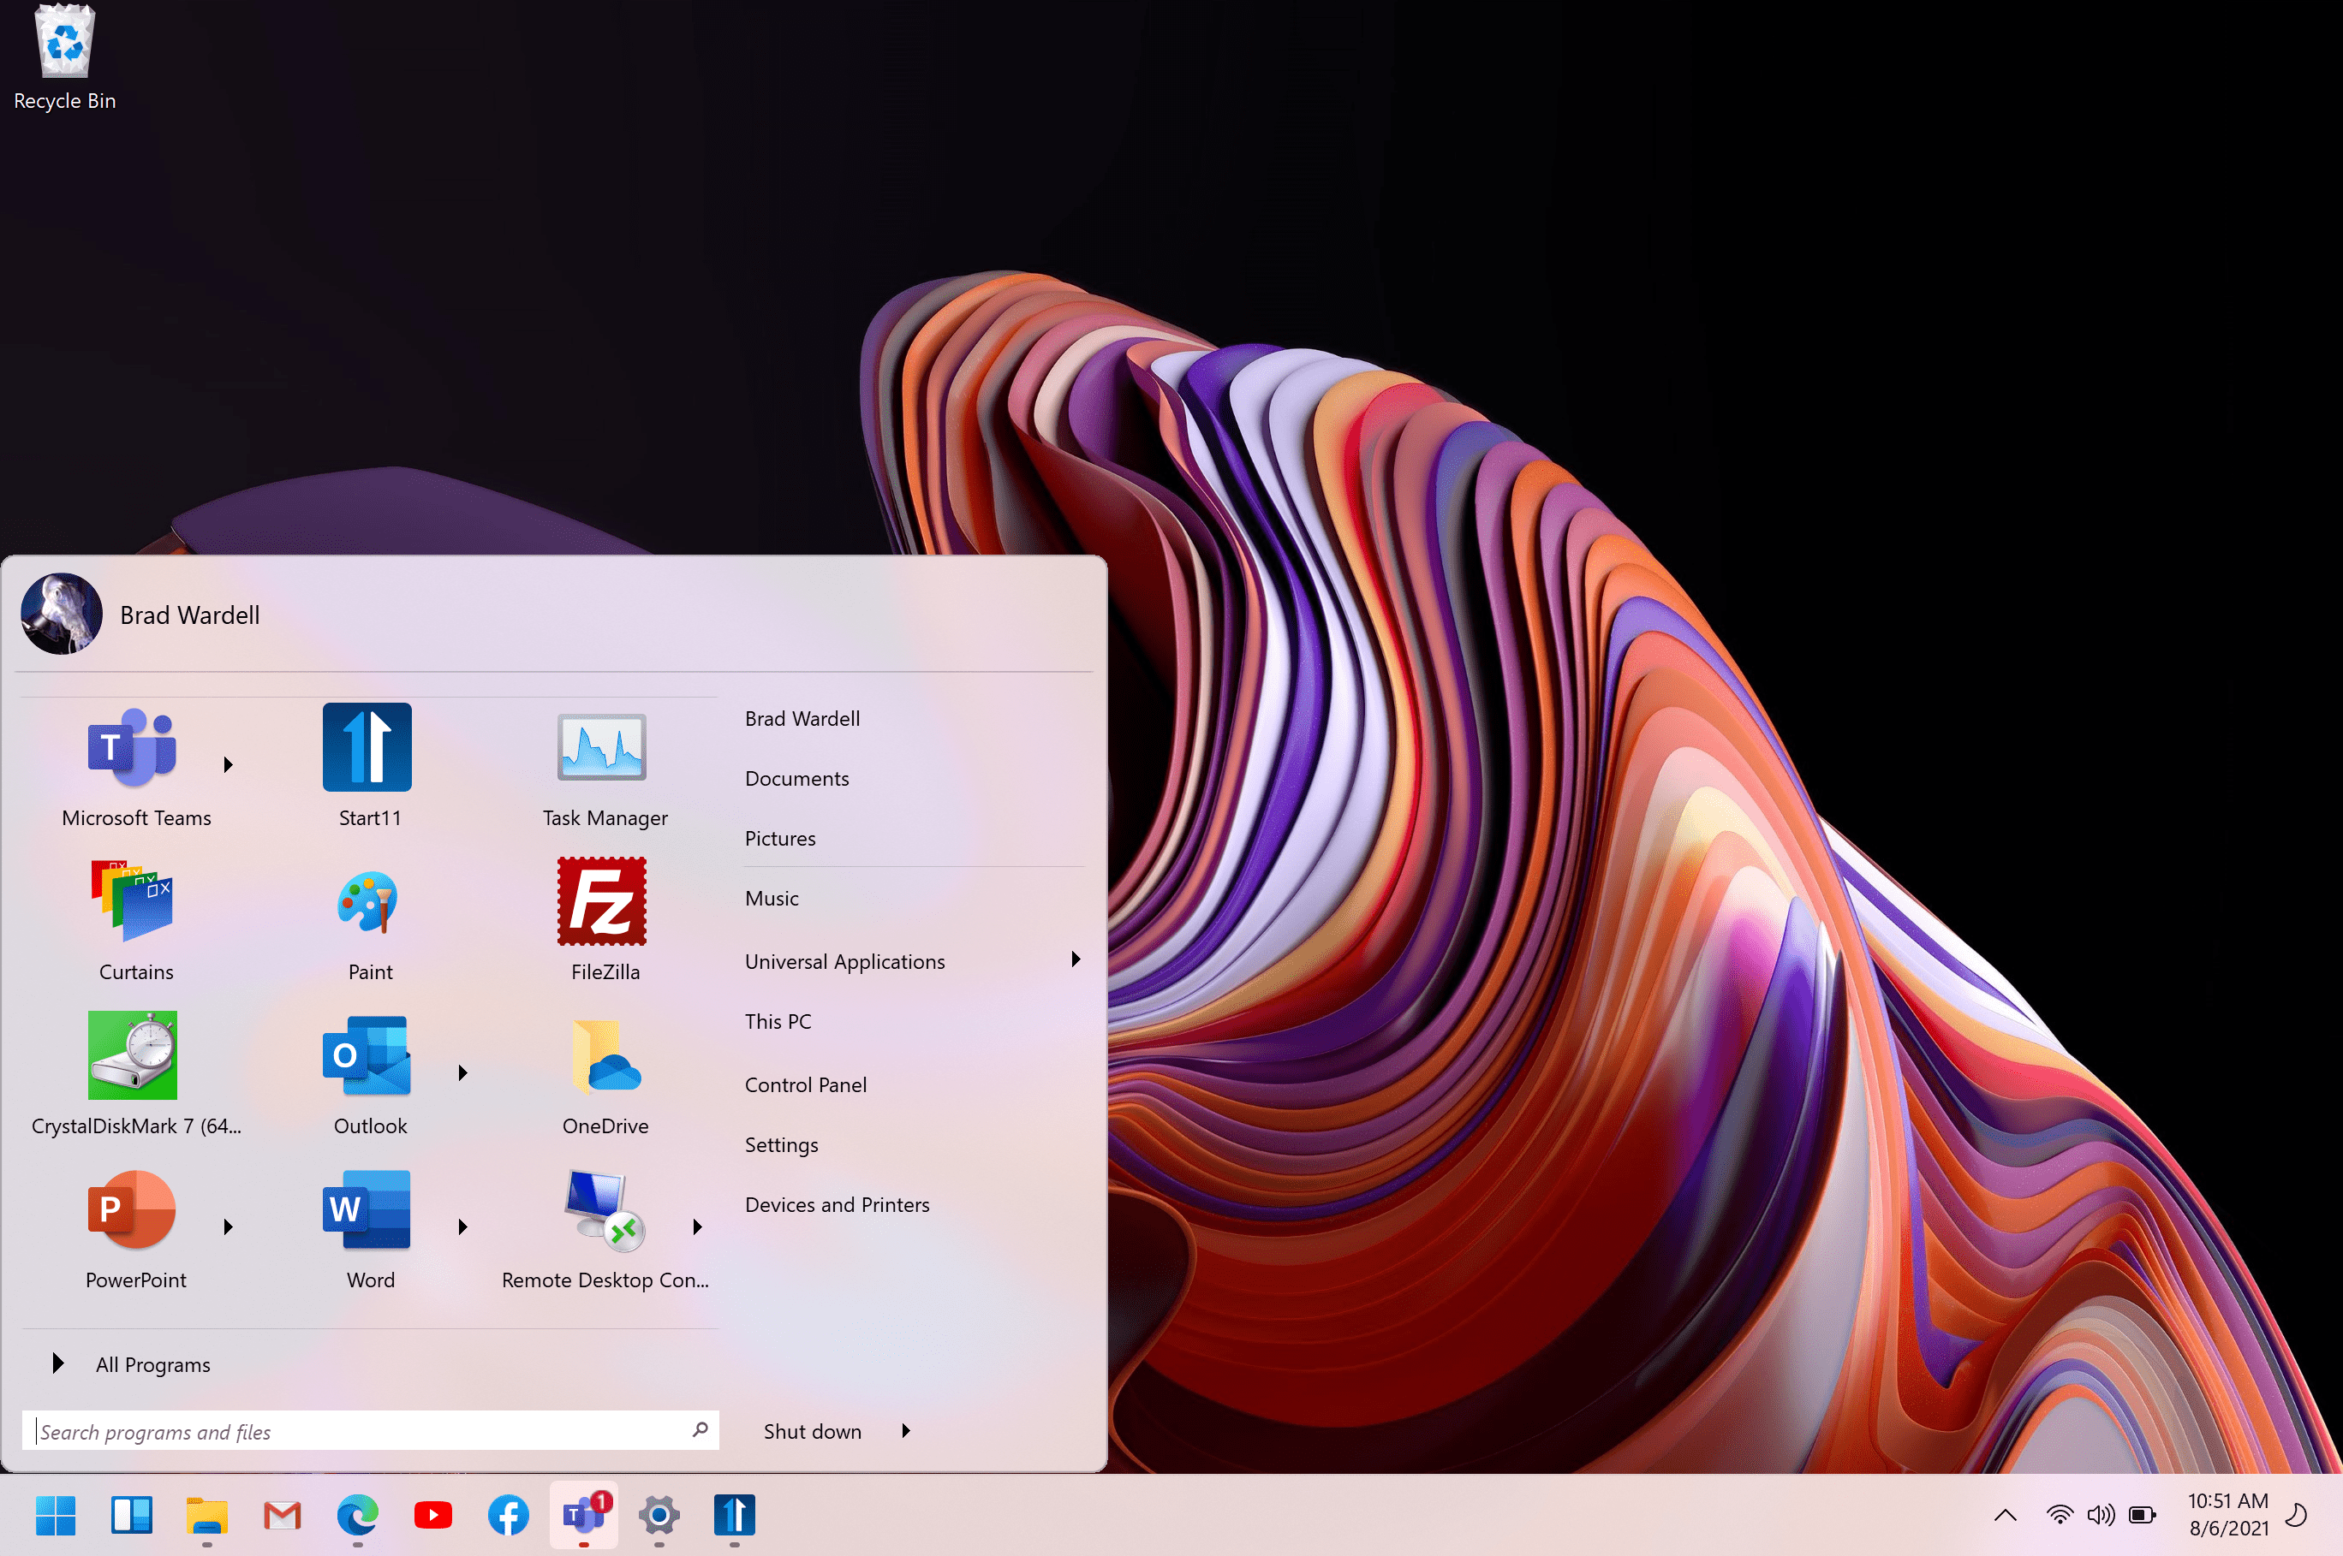
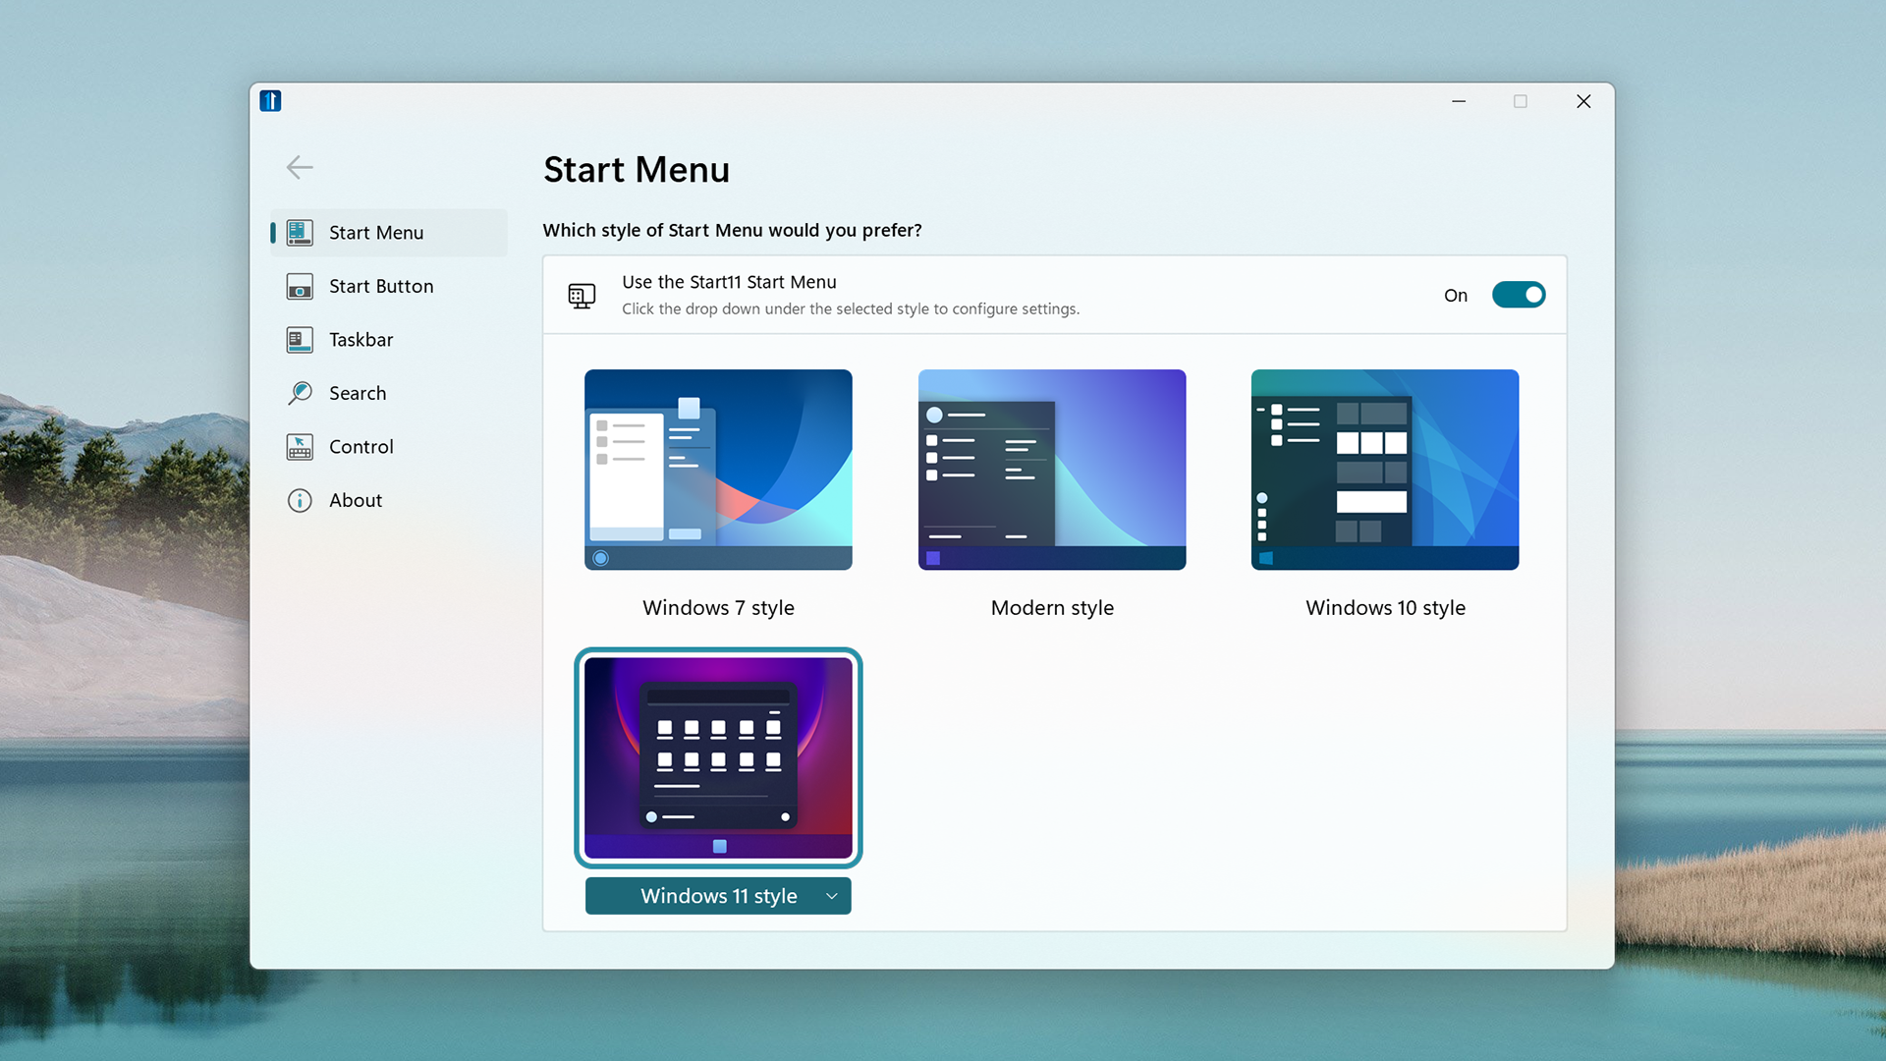
Microsoft tips
Start 11
Windows app
Customize the Windows 11 Task bar and Start menu
Make it look like Windows 10 – or whatever you want!
Notes:
If you've gotten a new PC lately, you may have been forced to upgrade to Windows 11. One of the major pain points for many users was the new task bar and start menu. Start 11 is a handy little utility that lets you customize the task bar and start menu. You can switch back to a Windows 7 or Windows 10 start menu, or customize it however you like. It also adds back functionality like ungrouping windows.

Slide 22
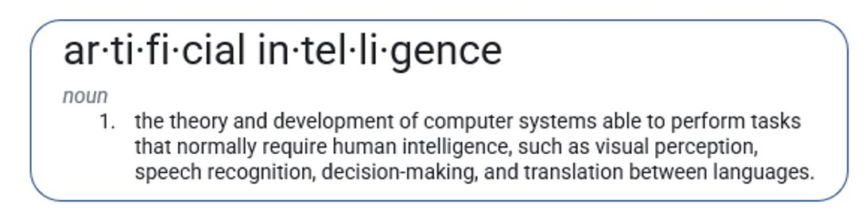
AI Introduction

Slide 23

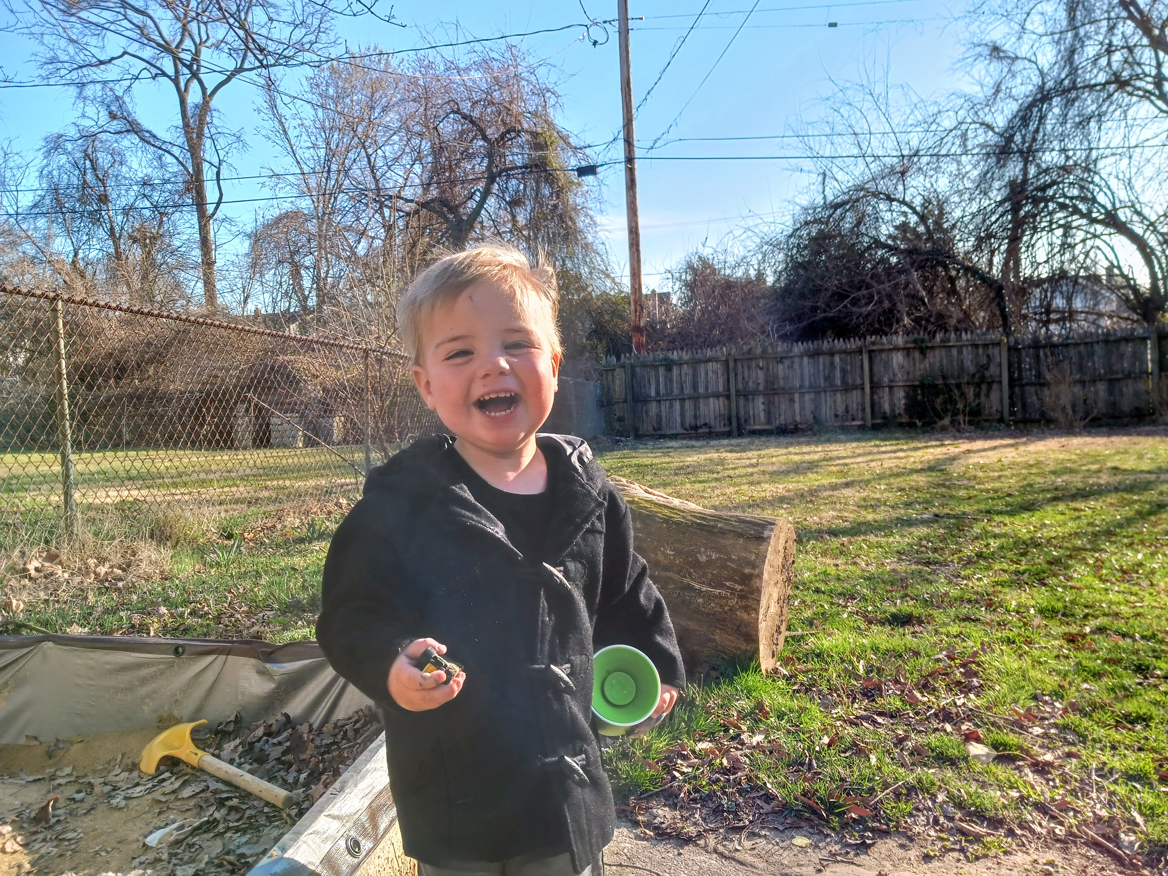
Visual Perception: Web site - Remove.bg
PhotoLayers app (Android)

Slide 24
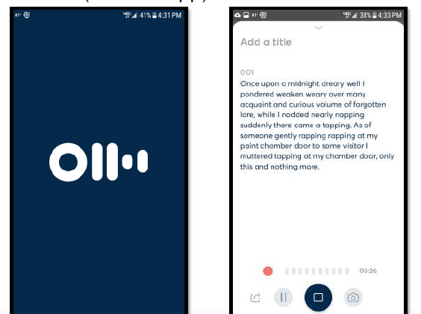
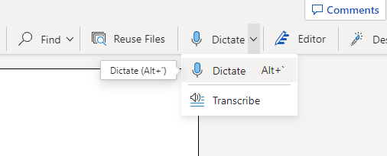
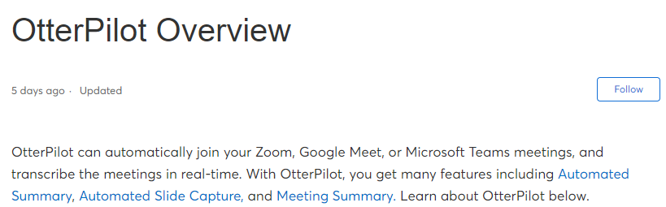
AI Tools – Speech to Text

Slide 25
Large Language Models
A type of artificial intelligence (AI) technology that uses advanced machine learning algorithms to process and generate natural language.
These models are trained on massive amounts of text data, allowing them to generate human-like text…
These have been around since at least the 1960s.

Slide 26
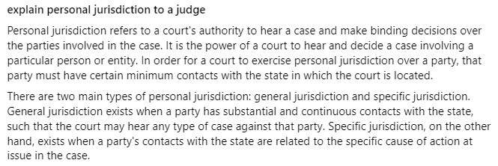
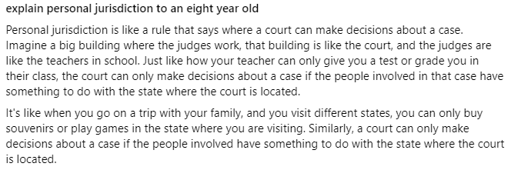
Nov. 30, 2022 – Chatgpt prototype 100,000,000 users in 2 months

Slide 27
Large Language Models
A large language model
"understands" through statistical analysis and probability
"creates" through combination of pattern, probability, and random sampling

Slide 28
Large Language Models
Good at:
Coherence
Summarizing large chunks of text
Re-writing text
First drafts when provided with detailed prompts
Bad at:
Searching for information (though some have been integrated with search engines)
Providing accurate facts

Slide 29
Recognized Dangers
Fictional information – dangerously plausible nonsense
LLMs will make up fictional cases, citations, and quotes
Training bias – GIGO
Privacy – who “learns” from your prompts?
Job elimination
Weaponization

Slide 30
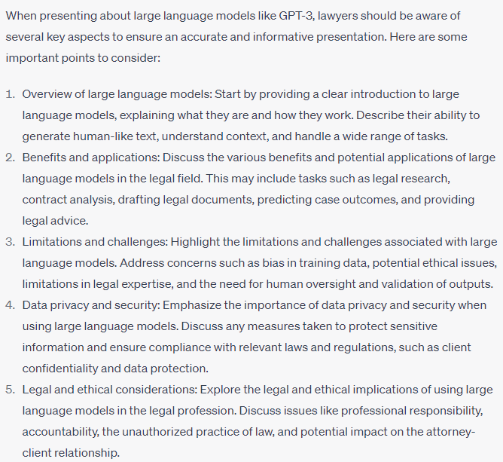
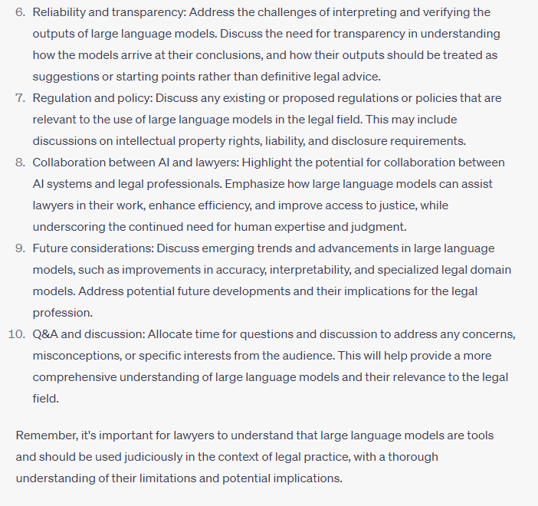
what are the things that lawyers need to know in a presentation about large language models

Slide 31
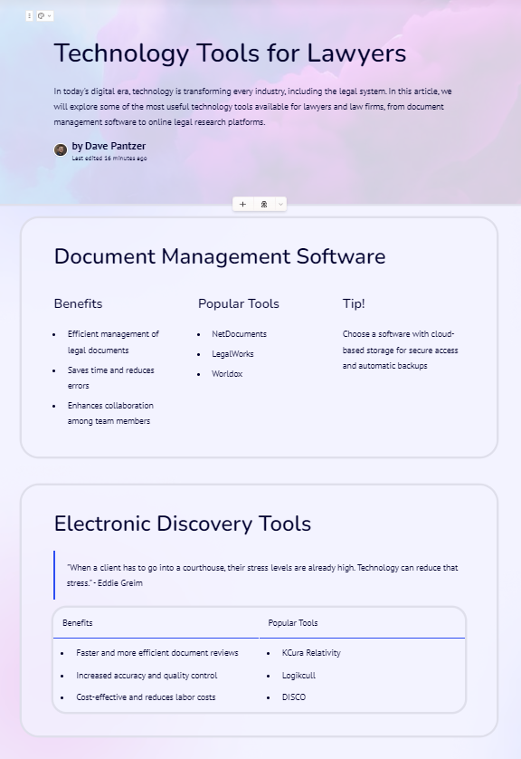
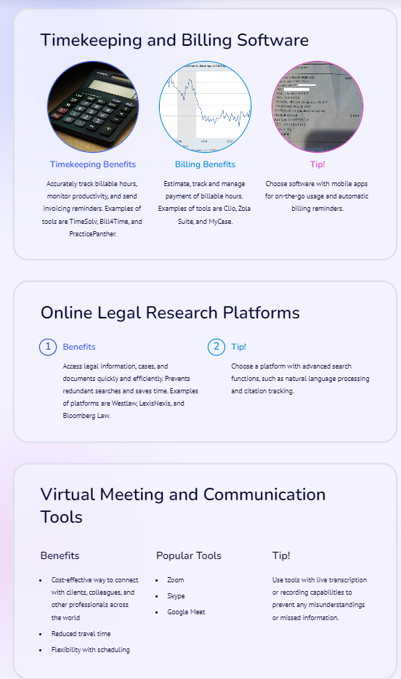
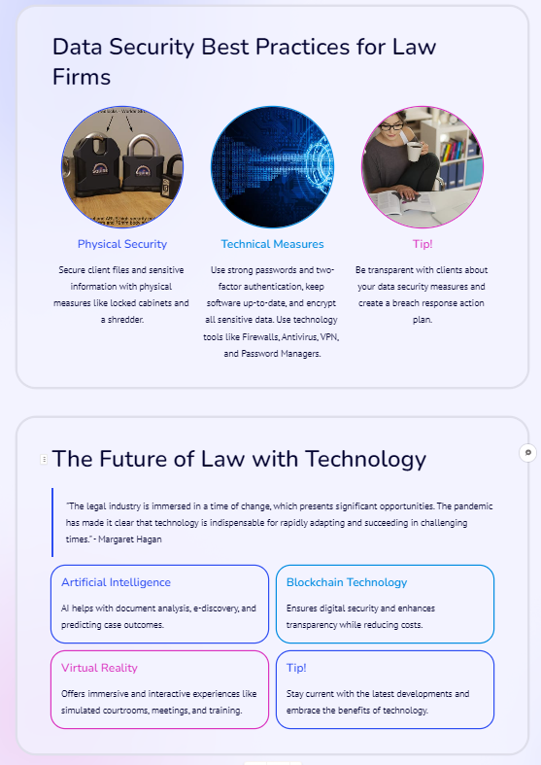
https://gamma.app - Technology Tools for Lawyers

Slide 32
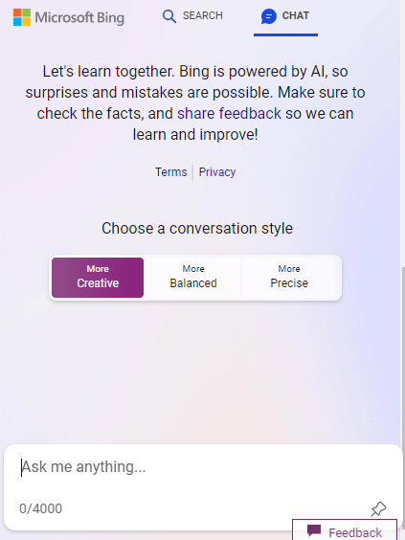
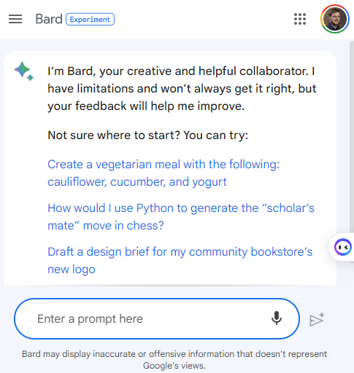
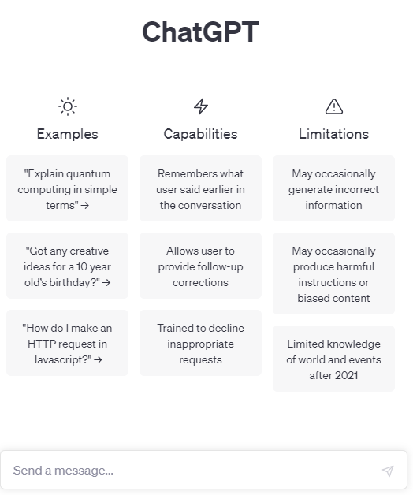
Trying it out… text output
Open AI https://chat.openai.com | Microsoft https://www.bing.com > Click Chat (From Edge) | Google https://bard.google.com
 | Various “styles” Provides some citations Realtime search

Slide 33
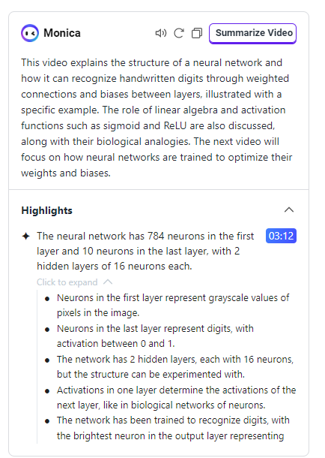
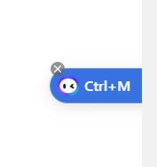
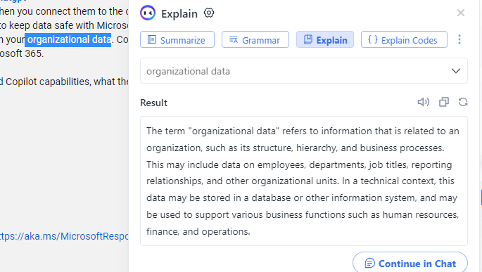
Some handy integrations
Monica (Chrome Extension)

Slide 34

Some handy integrations
ChatGPT for Google (Chrome Extension)

Slide 35



Trying it out… image creation
Canva AI https://www.canva.com/ai-image-generator/
Lawyers watching a conference presentation about AI in ocean city

Slide 36

Trying it out… image creation
DALL-E https://openai.com/product/dall-e-2
Lawyers watching a conference presentation about AI in ocean city

Slide 37


Trying it out… image creation
Microsoft https://www.bing.com > Click Chat (From Edge)
Lawyers watching a conference presentation about AI in ocean city

Slide 38
Trying it out… image creation
More
https://www.creativebloq.com/buying-guides/best-ai-art-generators

Slide 39

My questions: make it work on my data – ChatPDF

Slide 40

People's Law AI Search Tool

Slide 41

People's Law AI Search Tool

Slide 42

My questions: preventing the robots from learning from my data
https://www.youtube.com/watch?v=B2-8wrF9Okc

Slide 43

LLM’s and Law Practice – CaseText CoCounsel

Slide 44

How does an LLM work?

Slide 45

How does an LLM work?

Slide 46

How does an LLM work?

Slide 47

How does an LLM work?

